Slide 2
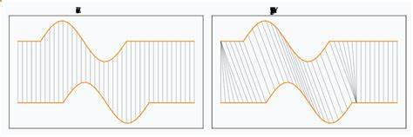
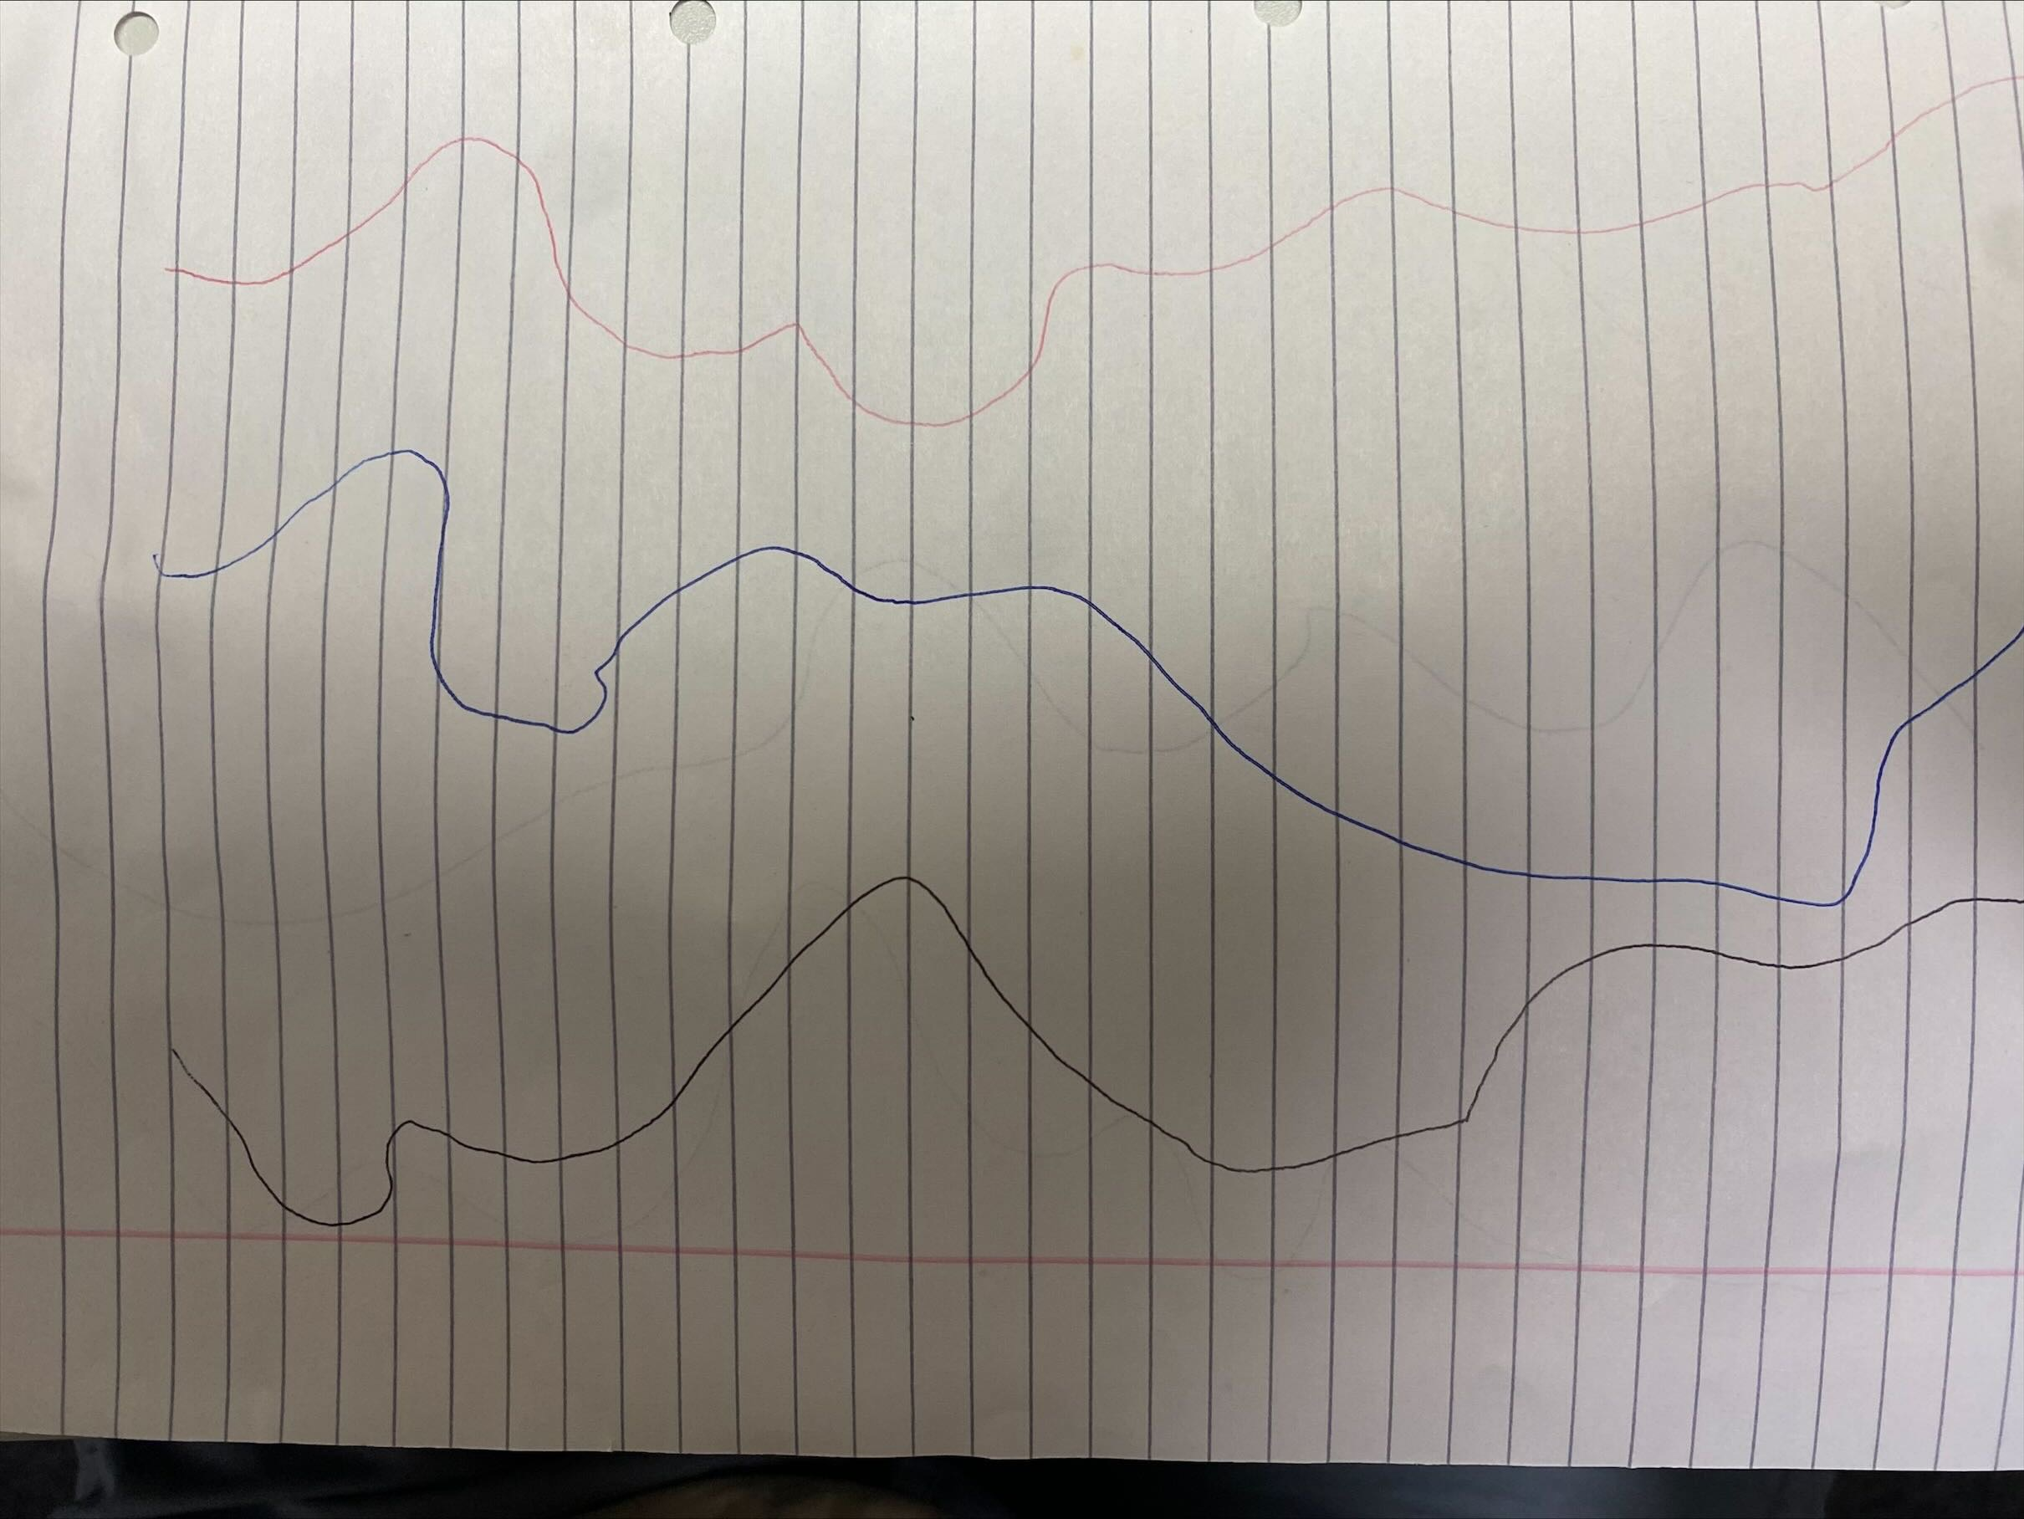
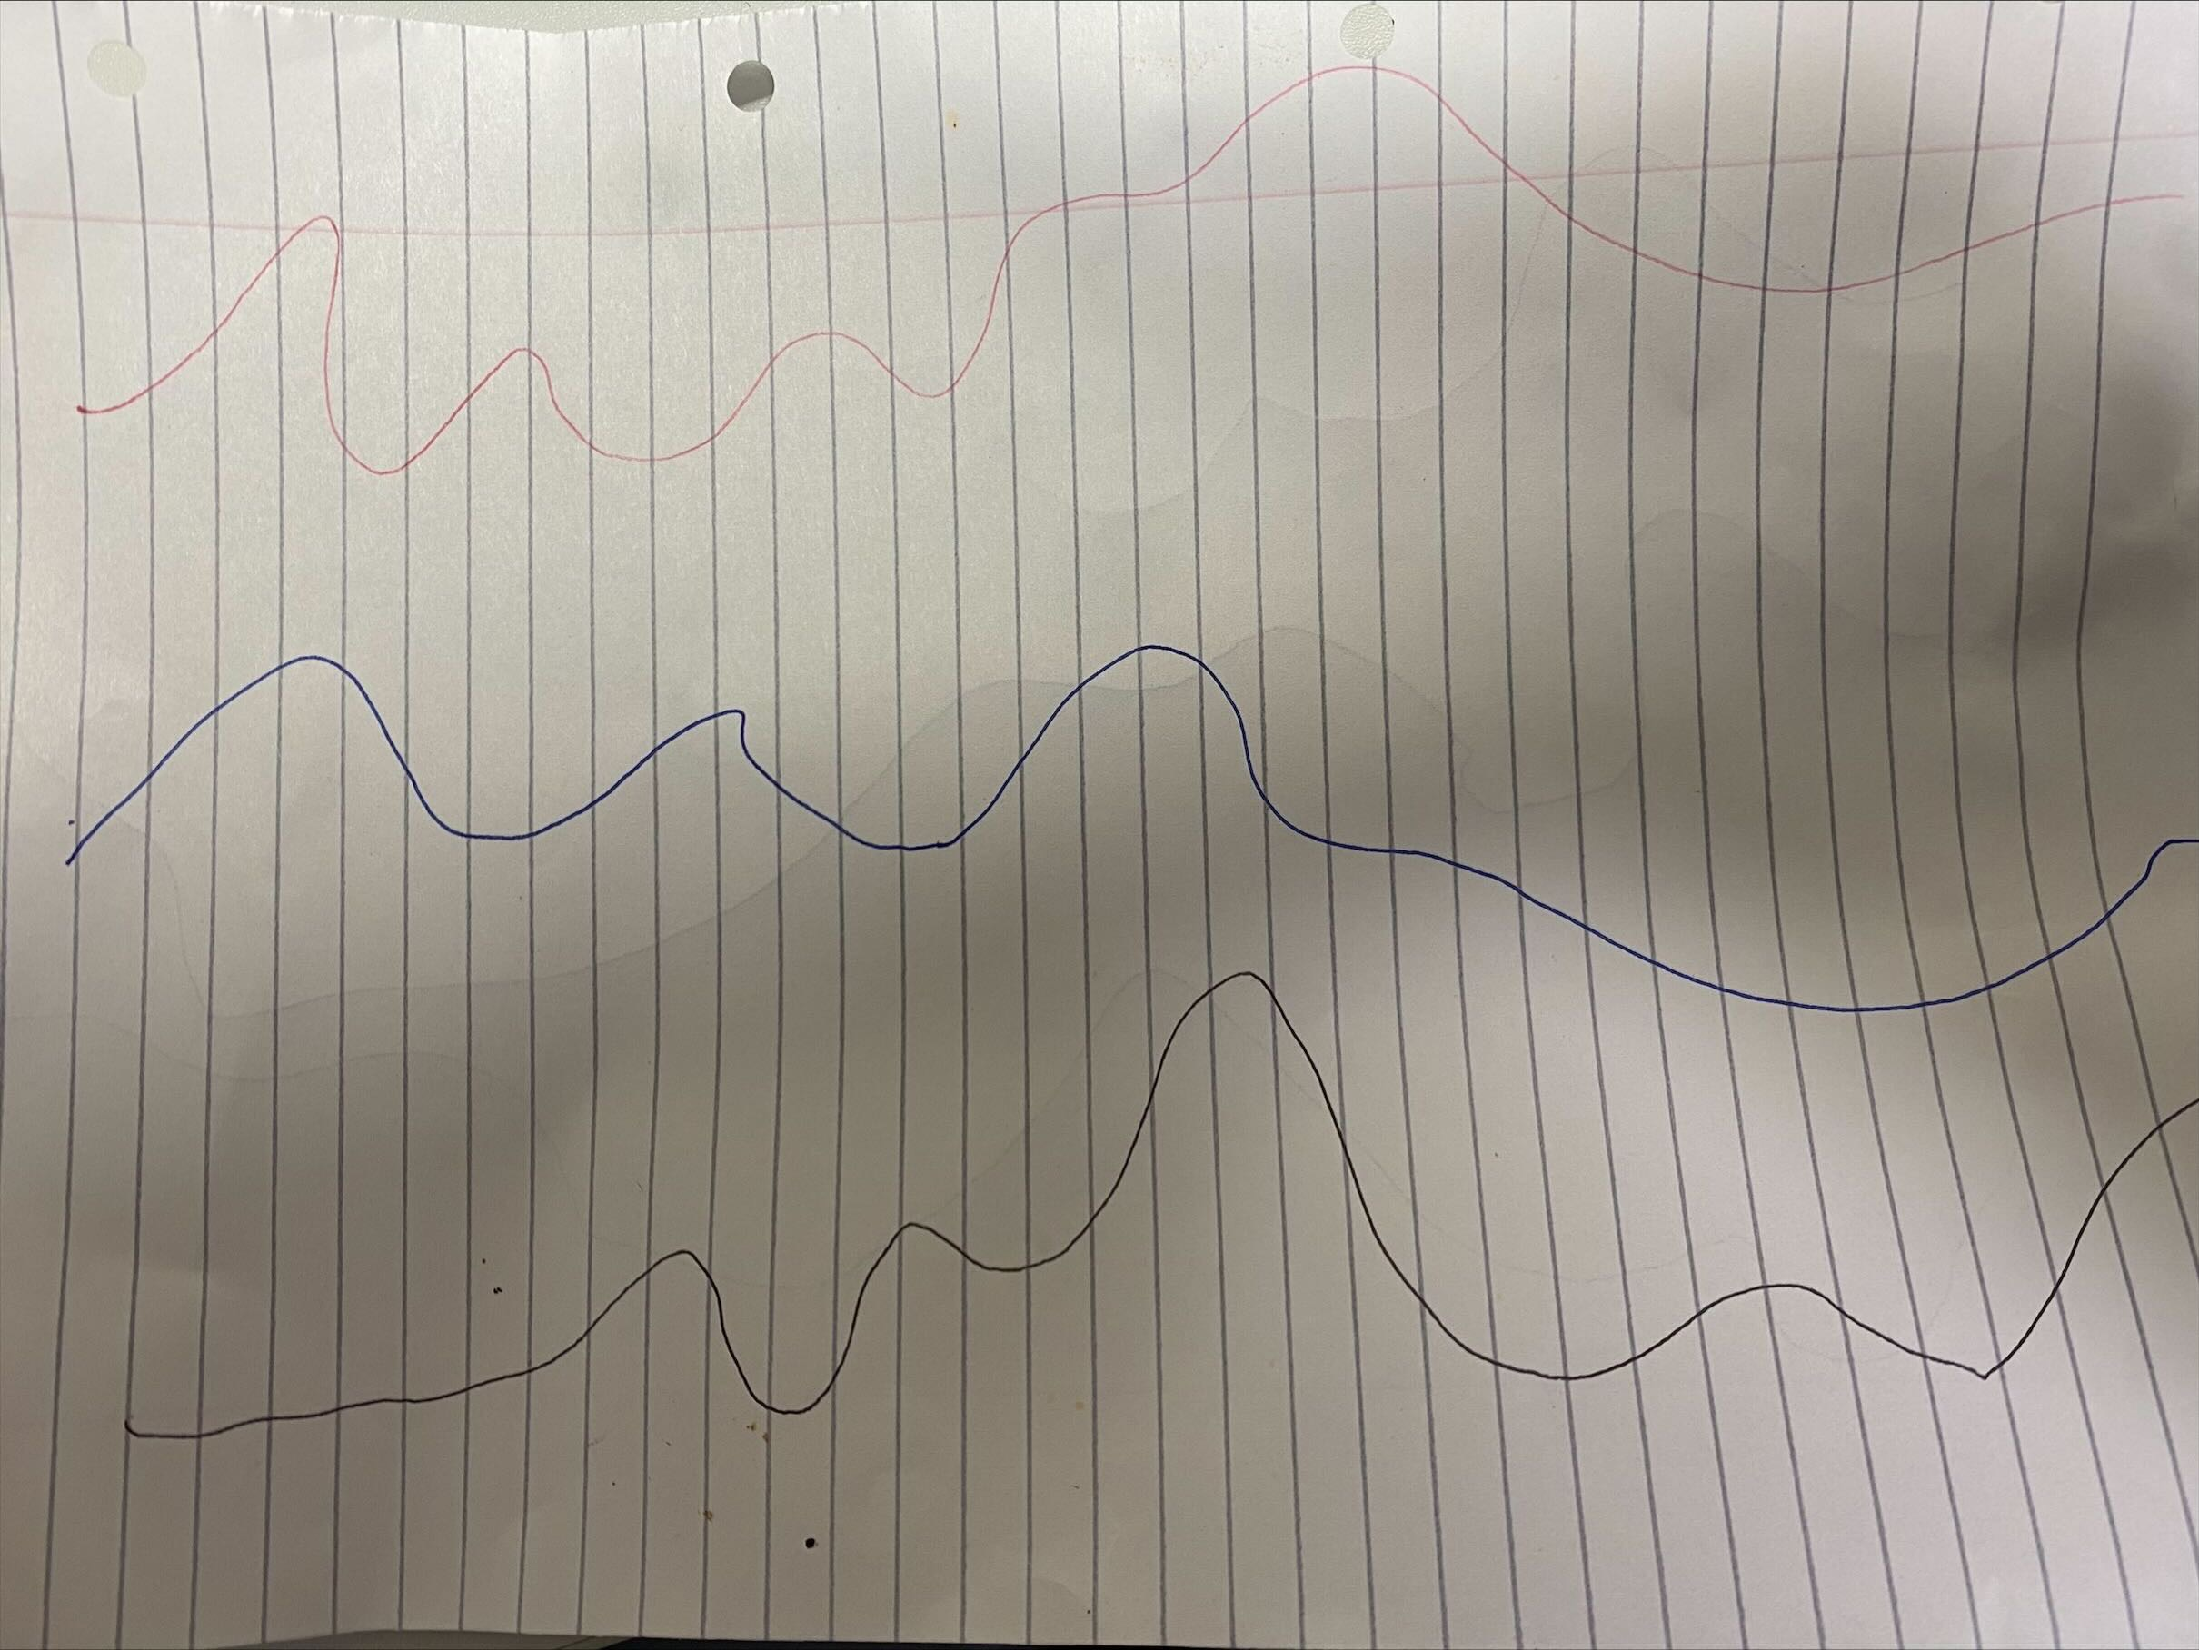
Dynamic Time Warping
Aim: Compare and score similarity of two pose estimations, while accounting for differences in speed in different parts of the form/swing, hence aligning the sequence of pose estimations together through warping the sequence.
Secondary Aim: Identify the variance of similarity of poses, throughout time and location to pinpoint where the most improvement is needed.
For the sake of real-time computation speed decided to switch from OpenPose to using OpenCV, requiring rewriting code.
Problem: We have multiple joints/vectors/angles in each pose estimation skeleton, so need a way to incorporate them all, as DTW was initially made for single variable comparisons.
Researched 3 potential Solutions.
1. Multiple uses of DTW: The simplest approach would be having broken down the skeleton into 10 joint angles, (x1,x2,…x10) for the user and (y1,y2,…,y10) for the professional and then apply DTW for each specific join/pair (xi, yi). Then we would get 10 simialirty scores one for each joint angle, and we can average the scores for an overall similarity score. However this can abuse the principles of DTW to artificially inflate the average similarity score, falsely indicating the users form is better than it really is.
This is because it leads to different angles being warped in different directions, so the model portrays the user as closer to the pro than reality.
Remember DTW is only supposed to normalise for difference in speed and power, but by having a DTW for each angle, it allows for the form to just be incorrect: (professionals leg bends at same time as elbow extends, while the user is allowed to bend leg way before extending arm, but this is not penalised). This is called 'Overfitting' - the joints are just being considered indivisually, and not the relative timing of the movements between each other.

Slide 3
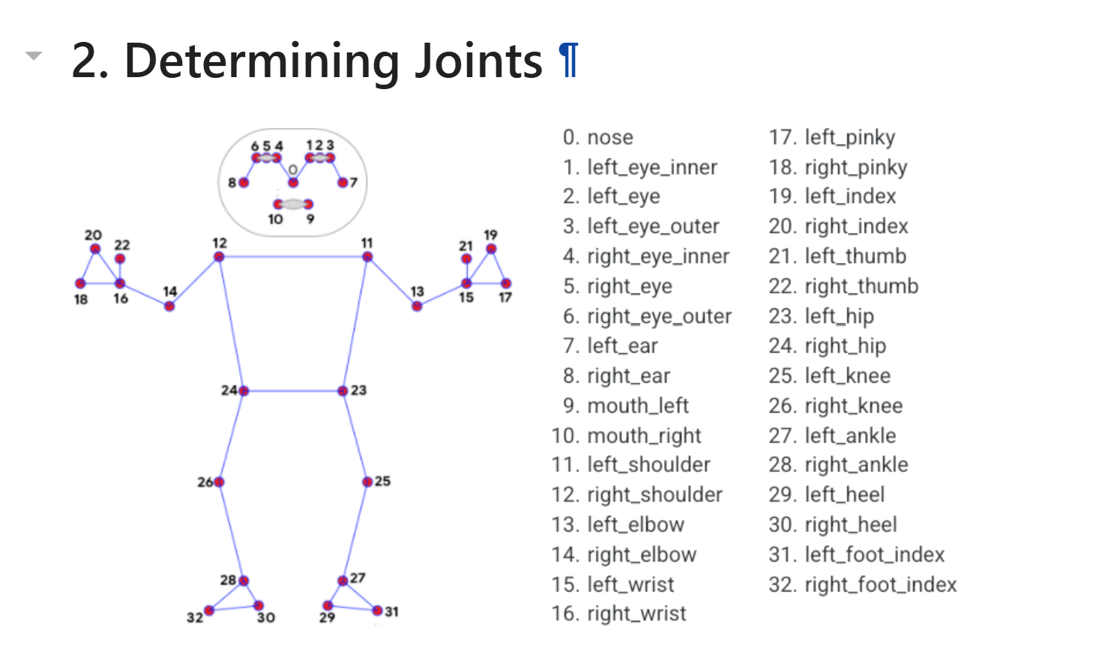
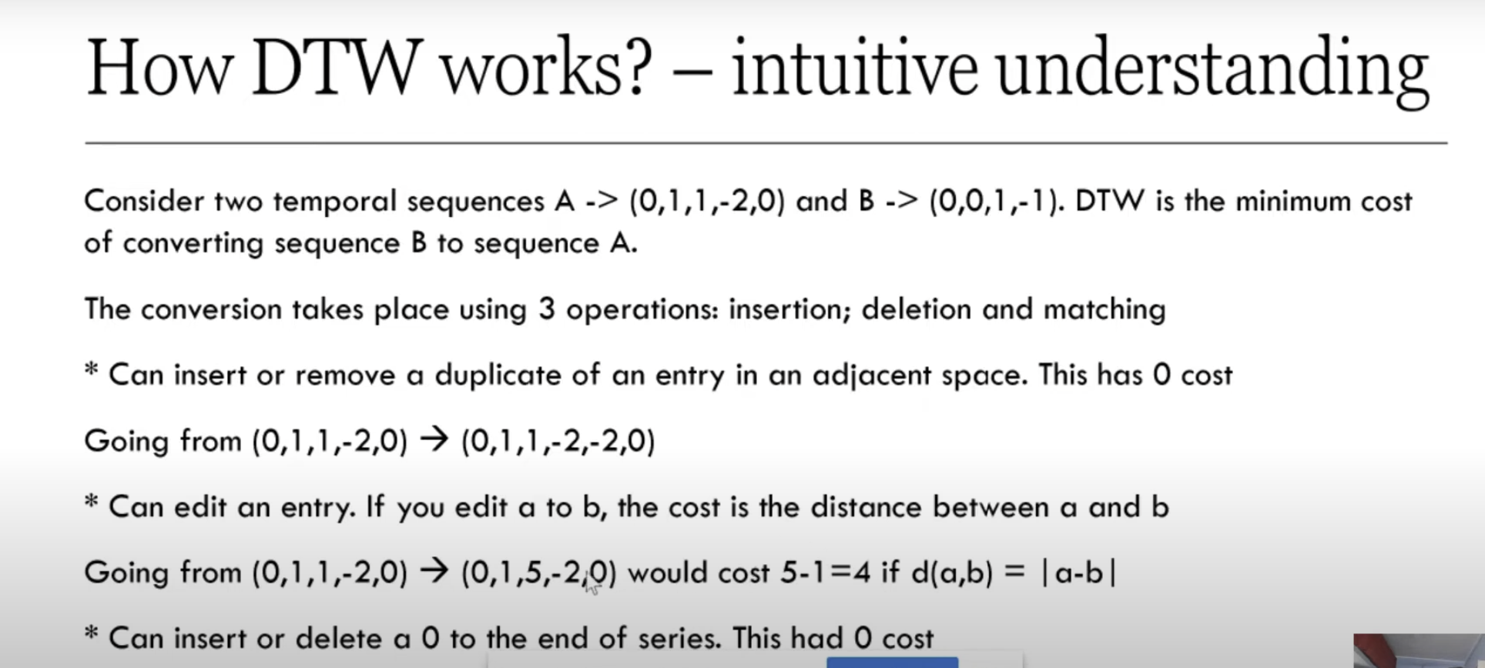
Dynamic Time Warping
2. ‘Anchored DTW’: In DTW not only do we gain a similarity score, but we also gain a ‘matching’ which tells us which points on one curve are being matched to points on the other curve. This essentially tells us how a curve has been warped. So, we will pick some key joint, like the elbow (as this captures the racket) – hence we will synchronise the users elbow movement to the professionals, gaining the warping pattern. Then we will project with warping pattern onto the other users of joint’s curves so that the are warped in the same way as the elbow. Hence any out of synchronisation from other joints relative to the fixed ‘elbow’ will be captured. We will then use Euclidian distance to gain similarity scores for all the join-angles. The advantage is there is no overfitting, as every joint will be warped in the same way, while still normalising for speed and strength in the user's arm.
3. Multi-dimensional DTW – This is an adaption of the normal DTW dynamic programming algorithm. This compares DTW with multiple variables for the curves. Hence each point in the curve now is a vector instead of a number. This could be used with comparing our 10 joint angles however we have to be careful as the more variable used, the less meaningful and accurate the results of DTW, as the algorithm is having to satisfy many curves simultaneously is can end up not matching any of the pairs very well. There are varying qualities to implementations as this is still being developed and some implementations are yet to be coded. 10 different variables like we have could potentially cause this problem. The advantage is that we warp all of the users curves in unison so avoid ‘overfitting’.
Conclusion: I will experiment with both method 2 and 3 to determine which is most viable for pose comparisons.
I will consider which achieves the aim and secondary aim best.
Demonstration of code so far

